Slide 1
Chapter 7
Recurrence Relations and Generating functions

Slide 2
Summary
Linear homogeneous recurrence relations
Generating functions
Recurrences and generating functions
A geometry example
Exponential generating functions
Assignments

Slide 3
Linear Homogeneous Recurrence Relations

Slide 4
Linear Recurrence Relation
A sequence of numbers h₀, h₁,…, h_{n}, … is said to satisfy a linear recurrence relation of order k, provided there exist quantities a₁, a₂, …, a_{k}, with a_{k} ≠ 0, and a quantity b_{n} (each of these quantities a₁, a₂, …, a_{k}, b_{n} may depend on n) such that
h_{n} = a₁h_{n-1}+a₂h_{n-2}+…+a_{k}h_{n-k}+b_{n}, (n ≥ k).

Slide 5
Examples
The sequence of derangement numbers D₀, D₁, D₂,…, D_{n} satisfy the two recurrence relations
D_{n} = (n-1)D_{n-1}+(n-1)D_{n-2}, (n ≥ 2)
D_{n} = nD_{n-1} + (-1)^{n}, (n ≥ 1).
The first recurrence relation has order ??? and we have a₁ = ??? a₂ =??? and b_{n} =???
The second ……..

Slide 6
Homogeneous
The linear recurrence relation
h_{n} = a₁h_{n-1}+a₂h_{n-2}+…+a_{k}h_{n-k}+b_{n}, (n ≥ k) is called homogeneous provided b_{n} = 0.
The linear recurrence relation is said to have constant coefficients provided a₁, a₂, …, a_{k} are constants.

Slide 7
Theorem 7.2.1
Let q be a non-zero number. Then h_{n} = q^{n} is a solution of the linear homogeneous recurrence relation
h_{n} – a₁h_{n-1} – a₂h_{n-2} – … – a_{k}h_{n-k}= 0, (a_{k} ≠ 0, n ≥ k) (7.20)
with constant coefficients iff q is a root of the polynomial equation
x^{k} – a₁x^{k-1} – a₂x^{k-2} – … – a_{k} = 0. (7.21)
If the polynomial equation has k distinct roots q₁, q₂, …, q_{k}, then h_{n} = c₁q₁^{n} + c₂q₂^{n} + … + c_{k}q_{k}^{n} (7.22)
is the general solution of (7.20) in the following sense: no matter what initial values for h₀, h₁, …, h_{k-1}are given, there are constants c₁, c₂, …, c_{k} so that (7.22) is the unique sequence which satisfies both the recurrence relation (7.20) and the initial conditions.

Slide 8
Comments
The polynomial equation (7.21) is called the characteristic equation of the recurrence relation (7.20) and its k roots are the characteristic roots.
If the characteristic roots are distinct, (7.22) is the general solution of (7.20).

Slide 9
Example
Solve the recurrence relation
h_{n} = 2h_{n-1}+h_{n-2} – 2h_{n-3}, (n ≥ 3)
subject to the initial values h₀ = 1, h₁ = 2 and h₂ = 0.
Hints: the characteristic equation of the recurrence relation is x³ – 2x² – x + 2 = 0 and its three roots are 1, -1 , 2. By Th.7.2.1, h_{n} = c₁1^{n} + c₂(-1)^{n} + c₃2^{n} is the general solution. How to continue??????

Slide 10
Example
Words of length n, using only the three letters a, b, c are to be transmitted over a communication channel subject to the condition that no word in which two a’s appear consecutively is to be transmitted. Determine the number of words allowed by the communication channel.

Slide 11
Hints
Firstly, find the recurrence relation and then find its solution.
Let h_{n} denote the number of allowed words of length n. We have h₀ = 1 and h₁ = 3. Let n ≥ 2. If the first letter of the word is b or c, then the word can be completed in h_{n-1} ways. If the first letter is a , then second letter should be b or c. hence, h_{n} = 2 h_{n-1} + 2h_{n-2}, (n ≥ 2). Continue by yourself.
b
a | b

Slide 12
Exercises
Consider a 1-by-n chessboard. Suppose we color each square with one of the two colors red and blue. Let h_{n} denote the number of colorings in which no two squares that are colored red are adjacent. Find and verify a recurrence relation that h_{n} satisfies. Then derive a formula for h_{n}.
Solve the recurrence relation
h_{n} = 4h_{n-1} – 4h_{n-2}, (n ≥ 2) .

Slide 13
Comments
If the roots q₁, q₂, …, q_{k} of the characteristic equation are not distinct, then h_{n} = c₁q₁^{n}+c₂q₂^{n}+…+c_{k}q_{k}^{n} is not a general solution of the recurrence relation.

Slide 14
Theorem 7.2.2
Let q₁, q₂, …, q_{t} be the distinct roots of the characteristic equation of the linear homogeneous recurrence relation (7.20) with constants coefficients. Then if q_{i} is an s_{i}-fold root of the characteristic equation (7.21) , then the general solution of the recurrence relation is
h_{n} = H_{n}⁽¹⁾ + H_{n} ⁽²⁾ + … + H_{n}^{(t)}, where
H_{n}^{(i)} = c₁q_{i}^{n} + c₂nq_{i}^{n} + … + c_{si}n^{si-1}q_{i}^{n}
= (c₁ +c₂n+…+c_{si}n^{si-1})q_{i}^{n}.

Slide 15
Example
Solve the recurrence relation
h_{n} = 4h_{n-1} – 4h_{n-2}, (n ≥ 2) .
Hints: the characteristic equation is x²-4x+4 = 0. thus 2 is the twofold characteristic root. The general solution of the recurrence relation is
h_{n} = c₁2^{n} + c₂n2^{n}.

Slide 16
Exercise
Solve the recurrence relation
h_{n} = -h_{n-1} +3h_{n-2}+5h_{n-3} +2h_{n-4}, (n ≥ 4).

Slide 17
Generating Functions

Slide 18
What generating functions do?
Count the number of possibilities for a problem by means of algebra
Generating functions are Taylor series of infinitely differentiable functions
If we can find the function and its Taylor series, then the coefficients of the Taylor series give the solution to the problem.

Slide 19
Definition of generating functions
Let h₀, h₁, …, h_{n}, …… be an infinite sequence of numbers. Its generating function is defined to be the infinite series
g(x) = h₀ + h₁x + h₂x² +…+ h_{n}x^{n} +……
The coefficient of x^{n} in g(x) is the nth term h_{n} of the sequence, and thus x^{n} acts as a “place holder” for h_{n}.

Slide 20
Examples
1. The generating function of the infinite sequence 1, 1, 1, …, 1, …, each of whose terms equals 1 is
g(x) = 1 +x+x²+…+x^{n}+… = 1/(1-x)
2. Let m be a positive integer. The generating function for the binomial coefficients C(m, 0), C(m, 1) C(m, 2),…., C(m, m) is
g_{m}(x) = C(m, 0) +C(m, 1)x + C(m, 2)x² + …
+C(m, m)x^{m}
= (1+x)^{m} (by the binomial theorem).

Slide 21
Exercises
Let a be real number. By Newton’s binomial theorem, what is the generating function for the infinite sequence of binomial coefficients C(a, 0), C(a, 1) , …, C(a, n),…?
Let k be an integer and let the sequence h₀, h₁, h₂,…, h_{n}, …be defined by letting h_{n} equals the number of non-negative integral solution of e₁+e₂+…e_{k}=n. What is the generating function for this sequence?

Slide 22
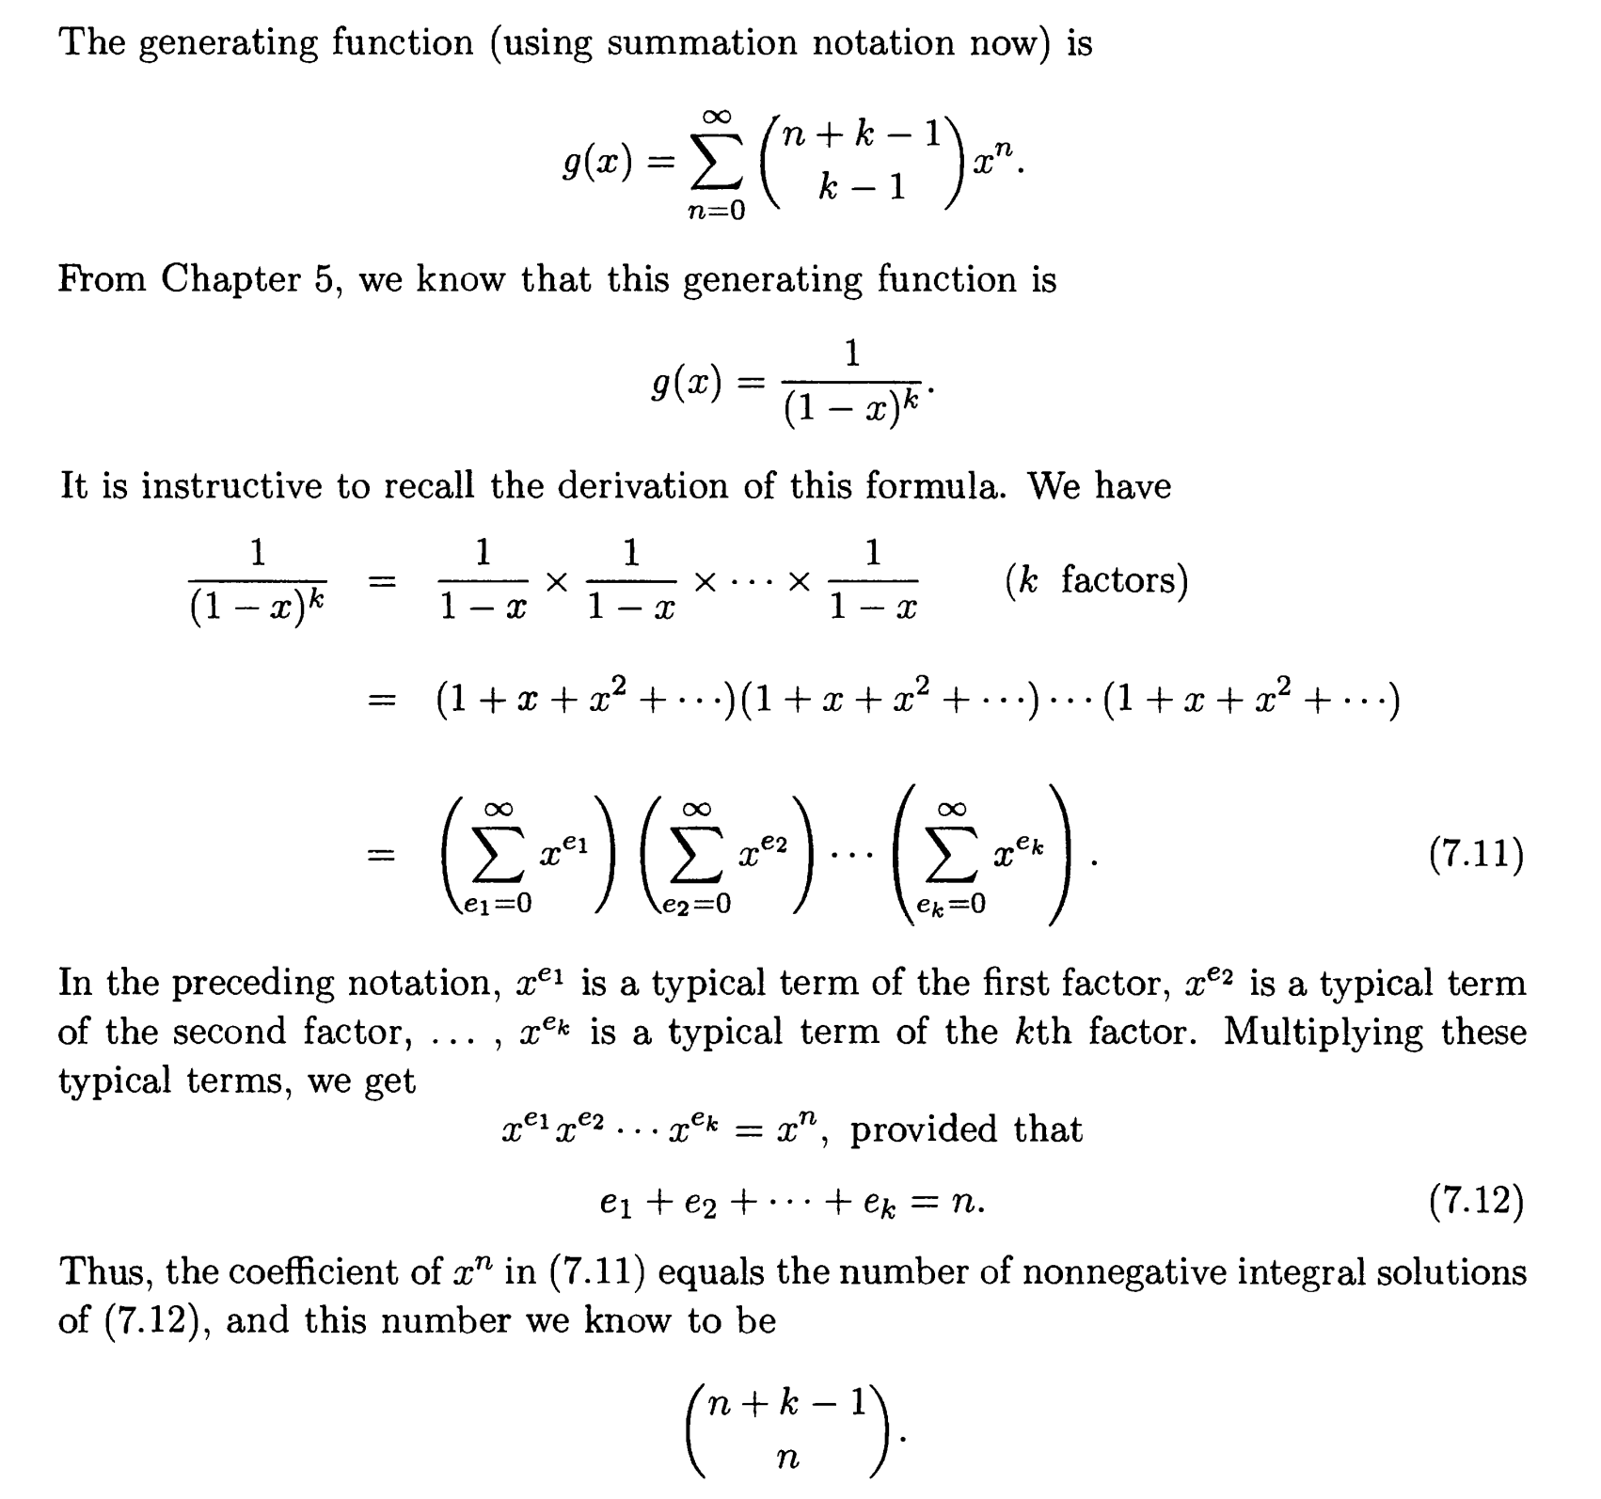

Slide 23
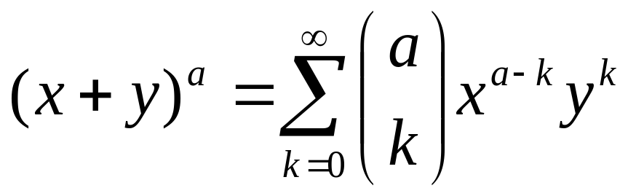
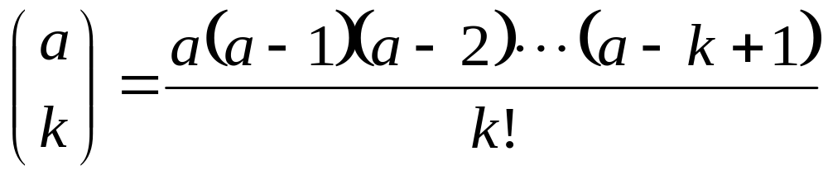
Review
Let a be a real number . Then for all x and y with 0 ≤ |x| <|y|,
where

Slide 24
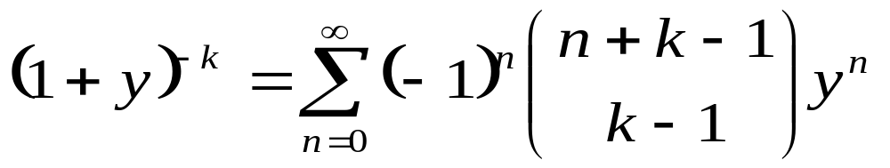
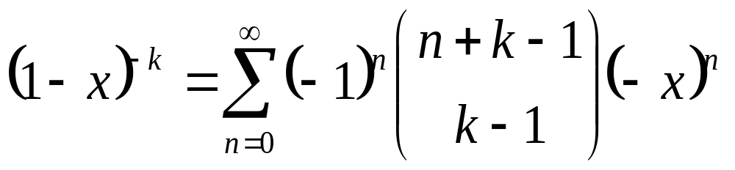
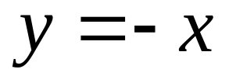
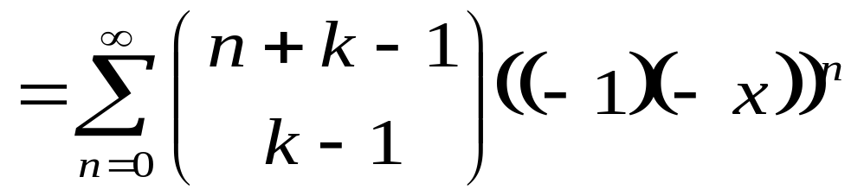
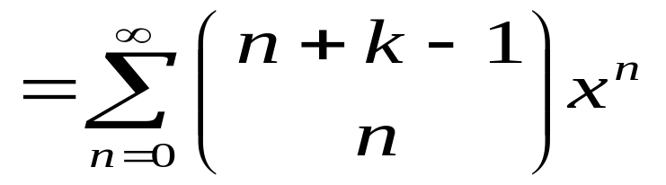
For |y|<1
Set

Slide 25
More examples
For what sequence is
(1+x+x²+x³+x⁴+x⁵)(1+x+x²)(1+x+x²+x³+x⁴) the generating function?
Let x^{e1}(0≤e₁≤5), x^{e2}, (0≤e₂≤2), and x^{e3} (0≤e₃≤4) denote the typical terms in the first, second and third factors, respectively. Multiplying we obtain x^{e1}x^{e2}x^{e3} = x^{n}, provided e₁ +e₂+e₃ = n. Thus the coefficient of x^{n} in the product is the number of h_{n} of integral solutions of e₁ +e₂+e₃ = n in which 0≤e₁≤5, 0≤e₂≤2 and 0≤e₃≤4. (note that h_{n} = 0 for n>11)

Slide 26
More examples (cont’d)
Determine the generating function for the number of n-combinations of apples, bananas, oranges, and pears where in each n-combination the number of apples is even, the number of bananas is odd, the number of oranges is between 0 and 4 and there is at least one pear.
Hints: the problem is equivalent to finding the number h_{n} of non-negative integral solutions of
e₁ + e₂ + e₃ + e₄ = n.

Slide 27
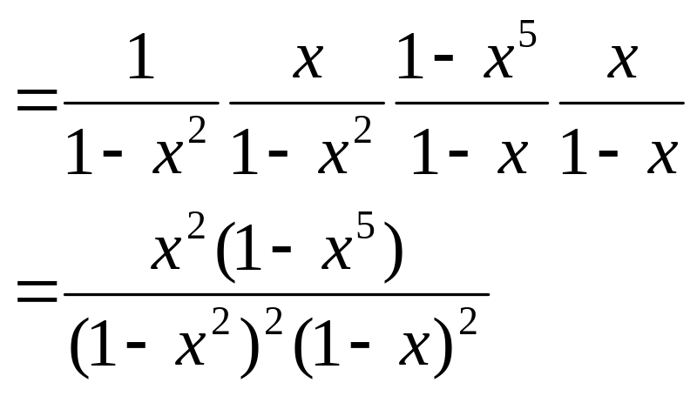
where e₁ is even (e₁ counts the number of apples), e₂ is odd, 0 ≤e₃≤4, and e₄ ≥1. We create one factor for each type of fruit where the exponents are the allowable number’s in the n-combinations for that type of fruit:
g(x) = (1 + x² + x⁴ +…)(x + x³ + x⁵ +…)(1 + x + x₂ +
x³ + x⁴) (x + x² + x³ + x⁴ +…)

Slide 28
Exercises
Determine the number h_{n} of bags of fruit that can be made out of apples, bananas, oranges, and pears where in each bag the number of apples is even, the number of bananas is a multiple of 5, the number of oranges is at most 4 and the number of pears is 0 or 1.
Hints: This is to calculate the coefficient of x^{n} for the generating functions of this problem.

Slide 29
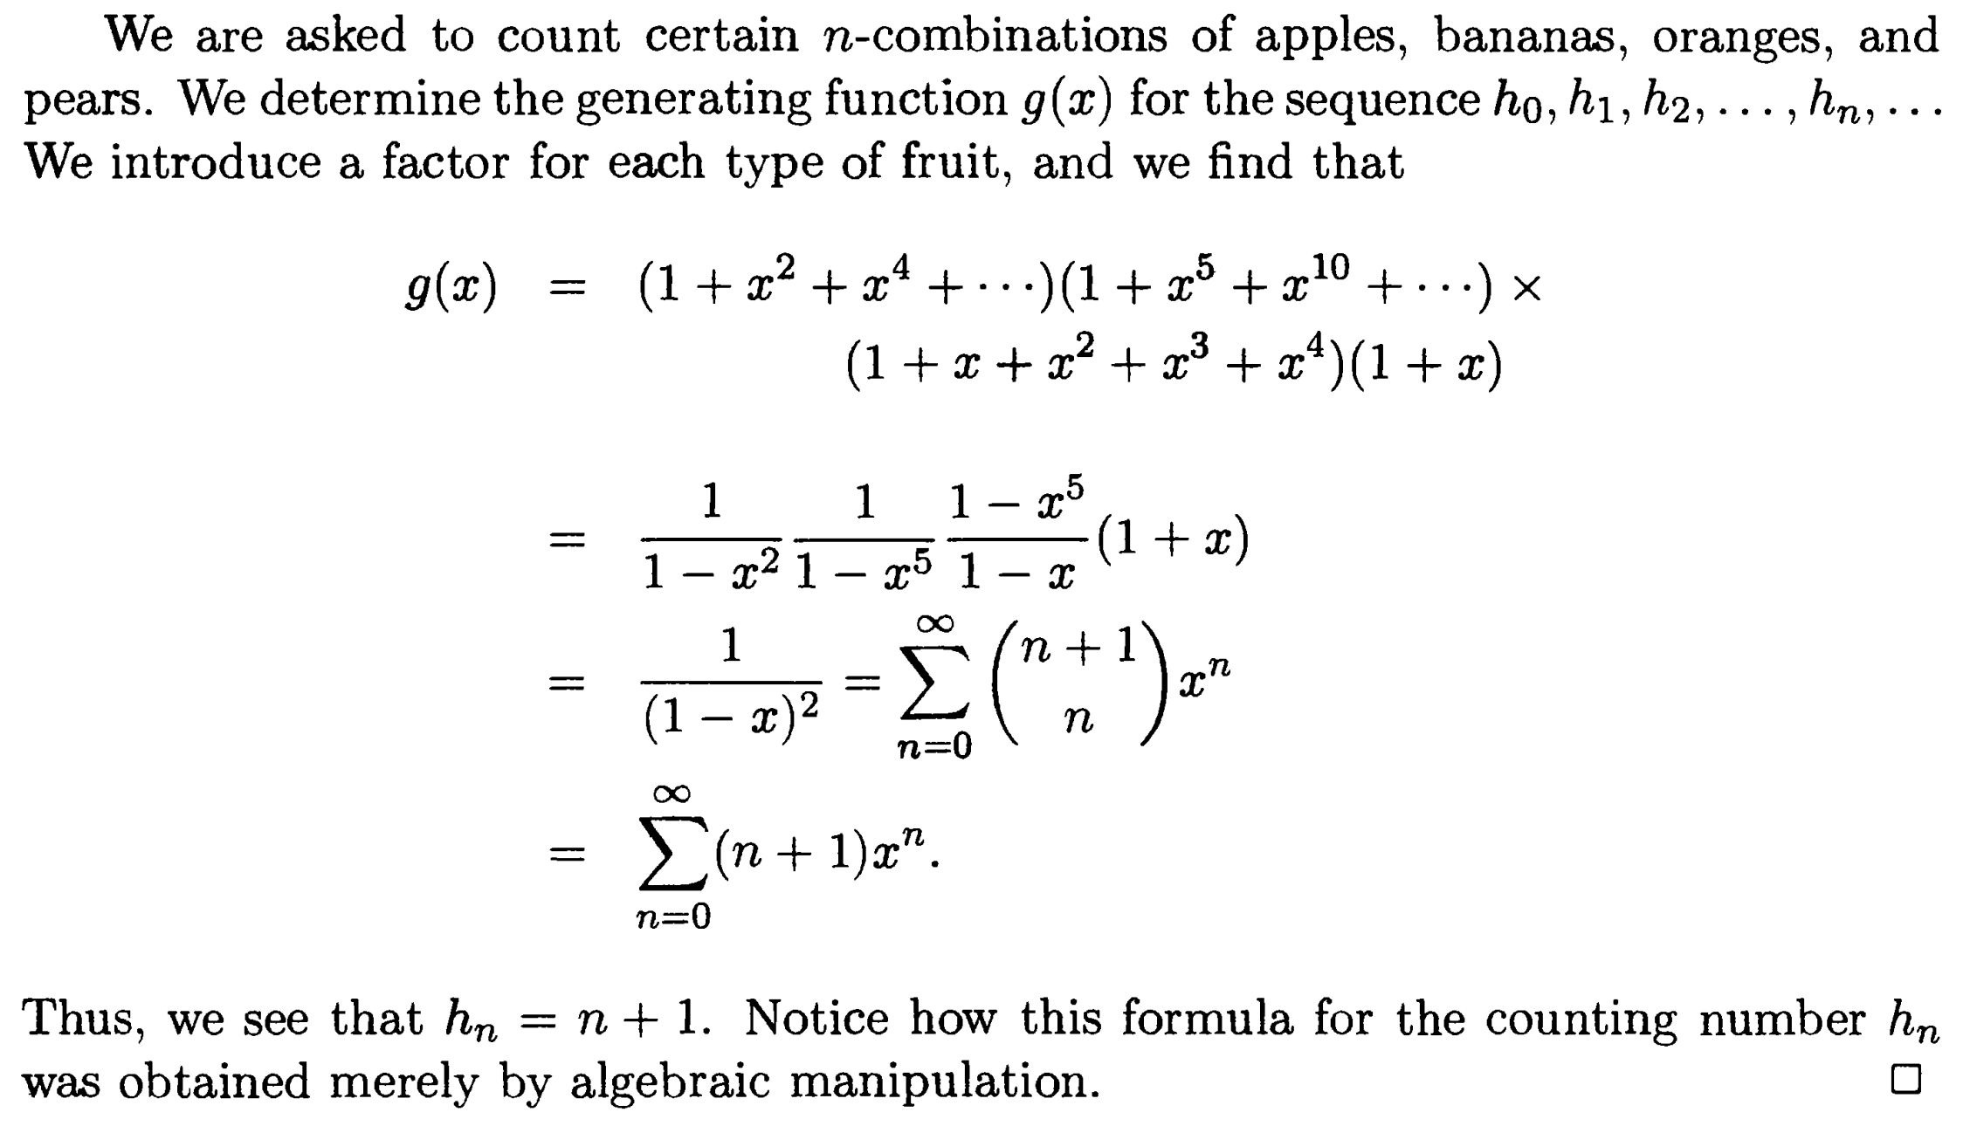

Slide 30
Exercises (cont’d)
Determine the generating function for the number h_{n} of solutions of the equation e₁ + e₂ + … + e_{k} = n in non-negative odd integers e₁, e₂, …, e_{k} .
Hints: ∏_{k} (x+x³+x⁵+x⁷+……).

Slide 31
Exercises (cont’d)
Let h_{n} denote the number of non-negative integral solutions of the equation
3e₁ + 4e₂ + 2e₃ + 5e₄ = n. Find the generating function g(x) for h₀, h₁, h₂, …, h_{n},…….
Hints: change the variable by let f₁ = 3e₁, f₂ = 4e₂, f₃ = 2e₃ and f₄ =5e₄. Then h_{n} also equals the number of non-negative integral solutions of f₁ + f₂ + f₃ + f₄ = n where f₁ is a multiple of 3, f₂ is a multiple of 4, f₃ is even and f₄ is a multiple of 5.
CONTINUE BY YOURSELF.

Slide 32
Recurrences and generating functions

Slide 33
What will be done?
Use generating functions to solve linear homogeneous recurrence relations with constant coefficients.
Newton’s binomial theorem will be applied.

Slide 34
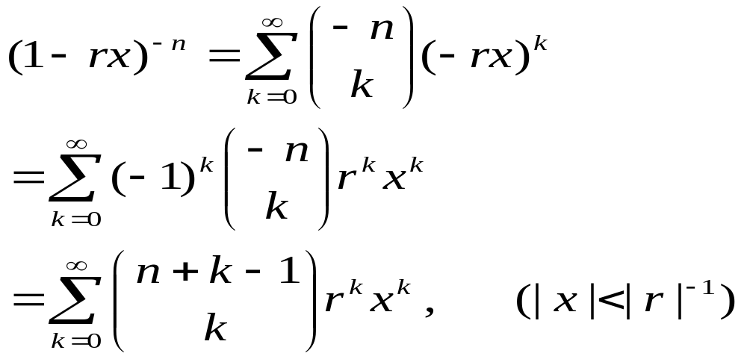
Review: Newton’s binomial theorem
If n is a positive integer and r is a non-zero real number, then

Slide 35
Examples
Determine the generating function for the sequence of squares 0, 1, 4, …, n²,…..
Solution: by the above Newton’s binomial theorem with n =2 and r =1,
(1-x)⁻² = 1+2x+3x²+…+nx^{n-1}+….
Hence x/(1-x)²=x+2x² + 3x³+…+nx^{n} +…..
Differentiating, we obtain
（1+x)/(1-x)³=1+2²x+3²x²+…+n²x^{n-1}+…..
Multiplying by x, we obtain the desired generating function x(1+x)/(1-x)^{3.}

Slide 36
Examples (cont’d)
Solve the recurrence relation
h_{n} = 5h_{n-1} – 6 h_{n-2}, (n≥2) subject to the initial values h₀ = 1 and h₁ = -2.
Hints: let g(x) = h₀+h₁x+h₂x²+…+h_{n}x^{n}+…. be the generating function for h₀, h₁, h₂, …, h_{n} … we then have the following equations

Slide 37
h_{n} = 5h_{n-1} – 6 h_{n-2}, (n≥2)
g(x) = h₀+h₁x+h₂x²+…+h_{n}x^{n}+….
-5xg(x) = -5h₀x -5h₁x² - 5h₂x³ -…- 5h_{n-1} x^{n} -….
6x² g(x) = 6h₀x² +6h₁x³ +6h₂x⁴ +…+6h_{n-2}x^{n} +….
Adding these three equations, we obtain
(1-5x+6x²)g(x) = h₀+(h₁-5h₀)x+(h₂-5h₁+6h₀)x²+…+(h_{n}-5h_{n-1}+6h_{n-2})x^{n}+….
= h₀+(h₁-5h₀)x = 1-7x (by assumptions)
Hence, g(x) = (1-7x)/(1-5x+6x²)
= 5/(1-2x) – 4/(1-3x)
Notes:
1。Given a broadcast/multicast, to determine broadcast/multicast tree(power of each node) such the total cost is minimized.
BIP(Broadcast Incremental Power), MIP, MST,SPT have been proposed. Performance through simulation.
2.3。 Each node have k levels power. To determine power level of each node, such that total cost of broadcast is minimized.
For 3, Heuristic algorithm based directed Steiner tree method was proposed.
Our work is similar with 2,, but our algorithm is better than 2.

Slide 38
By Newton’s binomial theorem
(1-2x)⁻¹ = 1+2x+2²x²+…+2^{n}x^{n}…..
(1-3x)⁻¹ = 1+3x+3²x²+…+3^{n}x^{n}…..
Therefore,
g(x) = 1 + (-2)x + (-15)x² +…+ (5×2^{n} – 4×3^{n})x^{n}+…
and we obtain
h_{n} = 5×2^{n} – 4×3^{n} (n = 0, 1, 2, …).

Slide 39
Exercise
Solve the recurrence relation
h_{n} = 3h_{n-2} - 2h_{n-3} (n≥3) subject to the initial values h₀ = 1, h₁ = 0 and h₂ = 0
Solve the recurrence relation
h_{n} + h_{n-1} – 16 h_{n-2}+20h_{n-3} = 0 (n≥3) subject to the initial values h₀ = 0, h₁ = 1 and h₂ = -1. (refer to the book)

Slide 40
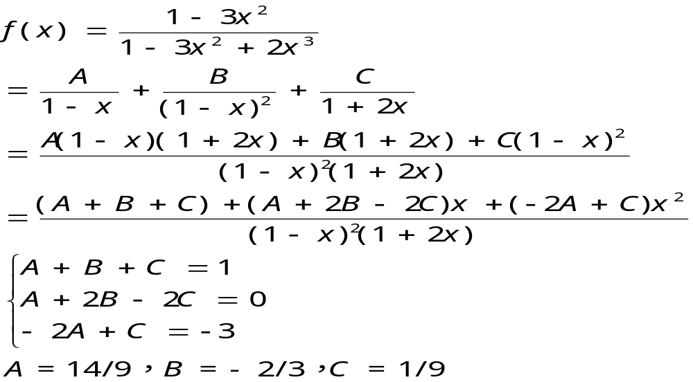
h_{n} = 3h_{n-2} - 2h_{n-3}

Slide 41
A geometry example

Slide 42
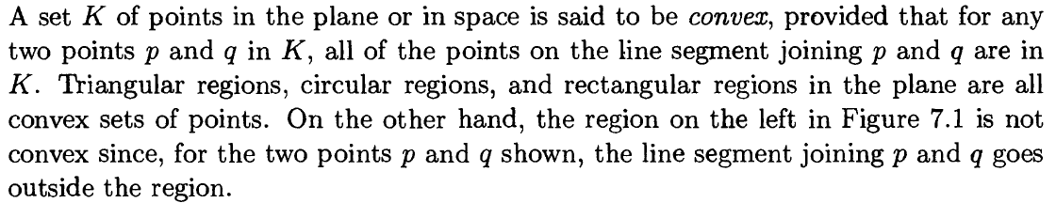
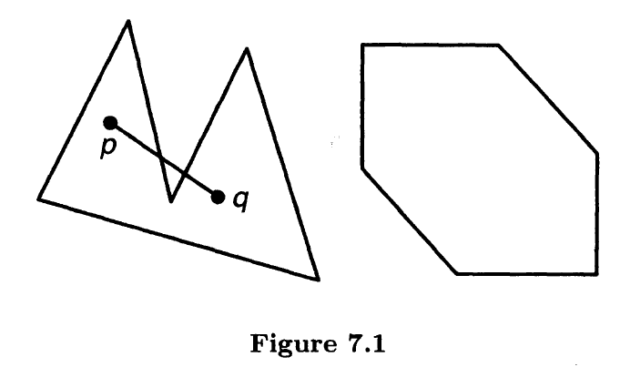

Slide 43
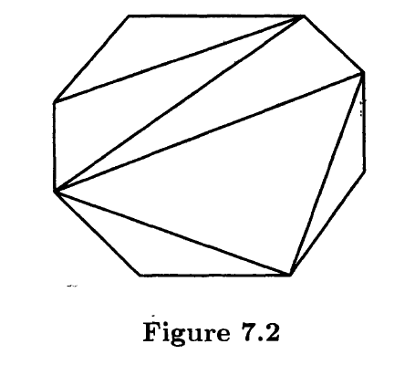
Ways to dividing a convex polygonal region
Let h_{n} denote the number of ways of dividing a convex polygonal region with n+1 sides into triangular regions by inserting diagonals which do not intersect in the interior.

Slide 44
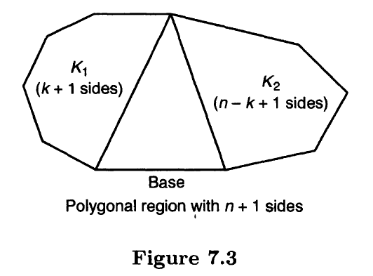

Slide 45
Define h₁ =1. Then h_{n} satisfies the recurrence relation
h_{n} = h₁h_{n-1}+h₂h_{n-2}+…+h_{n-1}h₁, (n≥2).
The solution of this recurrence relation is
h_{n} = n⁻¹C(2n-2, n-1), (n=1, 2 , 3, …).

Slide 46
Exponential generating functions

Slide 47
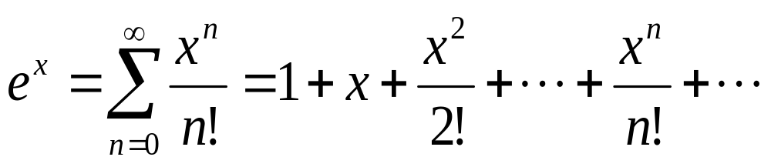
Review: Taylor’s series for e^{x}

Slide 48
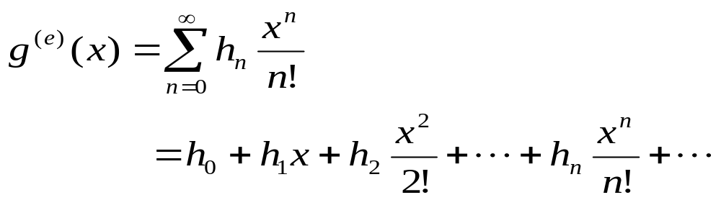
Definition of exponential generating functions
The exponential generating function for the sequence h₀, h₁, h₂, …, h_{n}, … is defined to be

Slide 49
Examples
Let n be a positive integer. Determine the exponential generating function for the sequence of numbers P(n, 0), P(n, 1), P(n, 2), …, P(n, n), where P(n, k) denote the number of k-permutations of an n-element set, and thus has the value n!/(n-k)! For k = 0, 1, …, n. The exponential generating function is

Slide 50
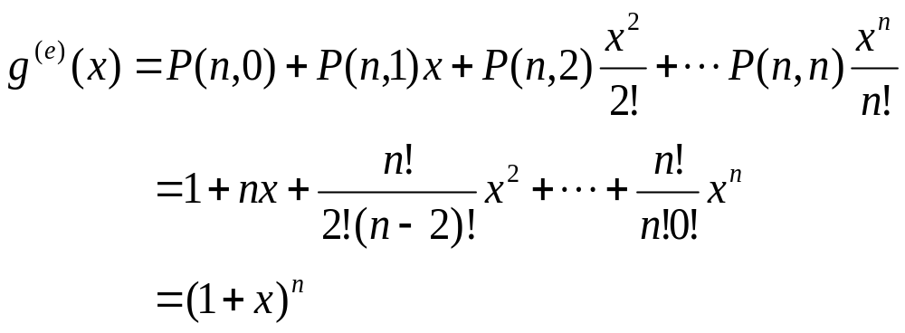
Thus (1+x)^{n} is both the exponential generating function for the sequence P(n, 0), P(n, 1), P(n, 2), …, P(n, n) and, as we have seen in previous section, the ordinary generating function for the sequence C(n, 0), C(n, 1), C(n, 2), …, C(n, n).

Slide 51
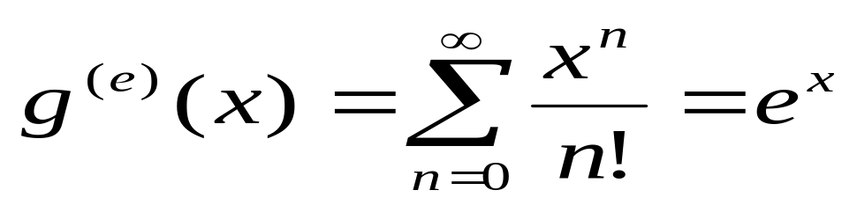
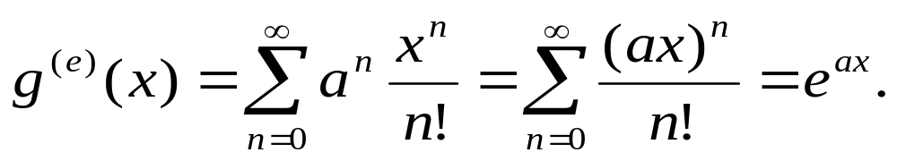
Examples (cont’d)
The exponential generating function for the sequence 1, 1, 1, …, 1, …. is
More generally, if a is any real number, the exponential generating function for the sequence a⁰ = 1, a, a², …, a^{n}, …. is

Slide 52
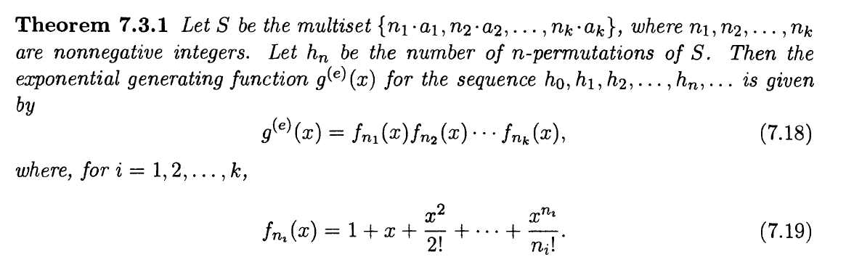
A Theorem

Slide 53
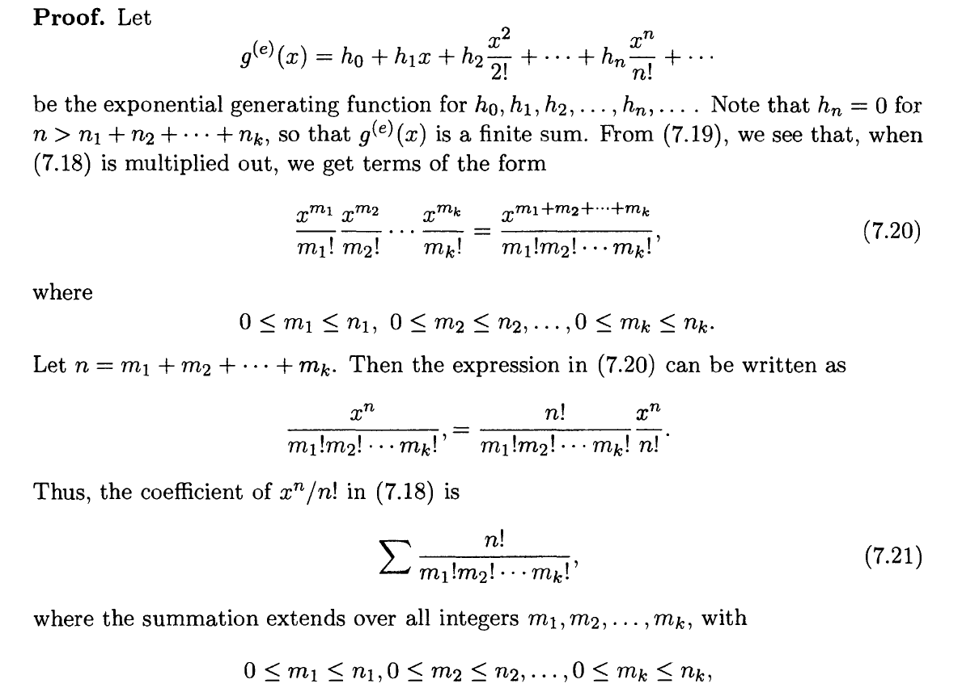
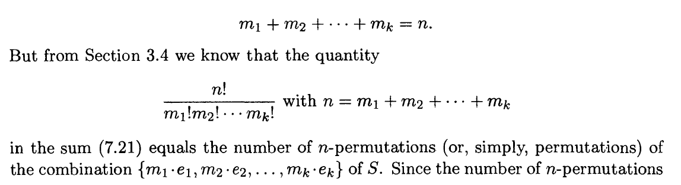
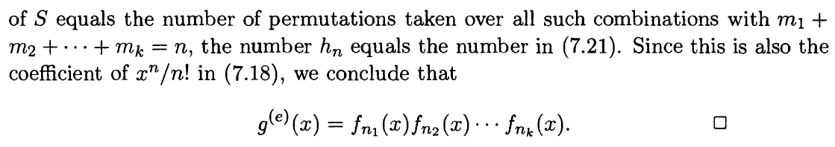

Slide 54
Examples
Determine the number of ways to color the squares of a 1-by-n chessboard, using the colors red, white, and blue, if an even number of squares are to be colored red.
Hints: Let h_{n} denote the number of such colorings where we define h₀ =1. Then h_{n} equals the number of n-permutations of a multiset of three colors, each with an infinite repetition number, in which red occurs an even number of times. Thus the exponential generating function for h₀, h₁, h₂,…, h_{n} ,… is the product of red, white and blue factors:

Slide 55
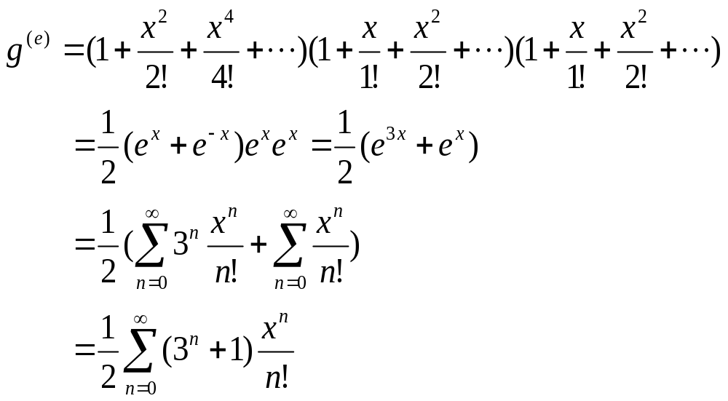
Hence, h_{n} = (3^{n}+1)/2.

Slide 56
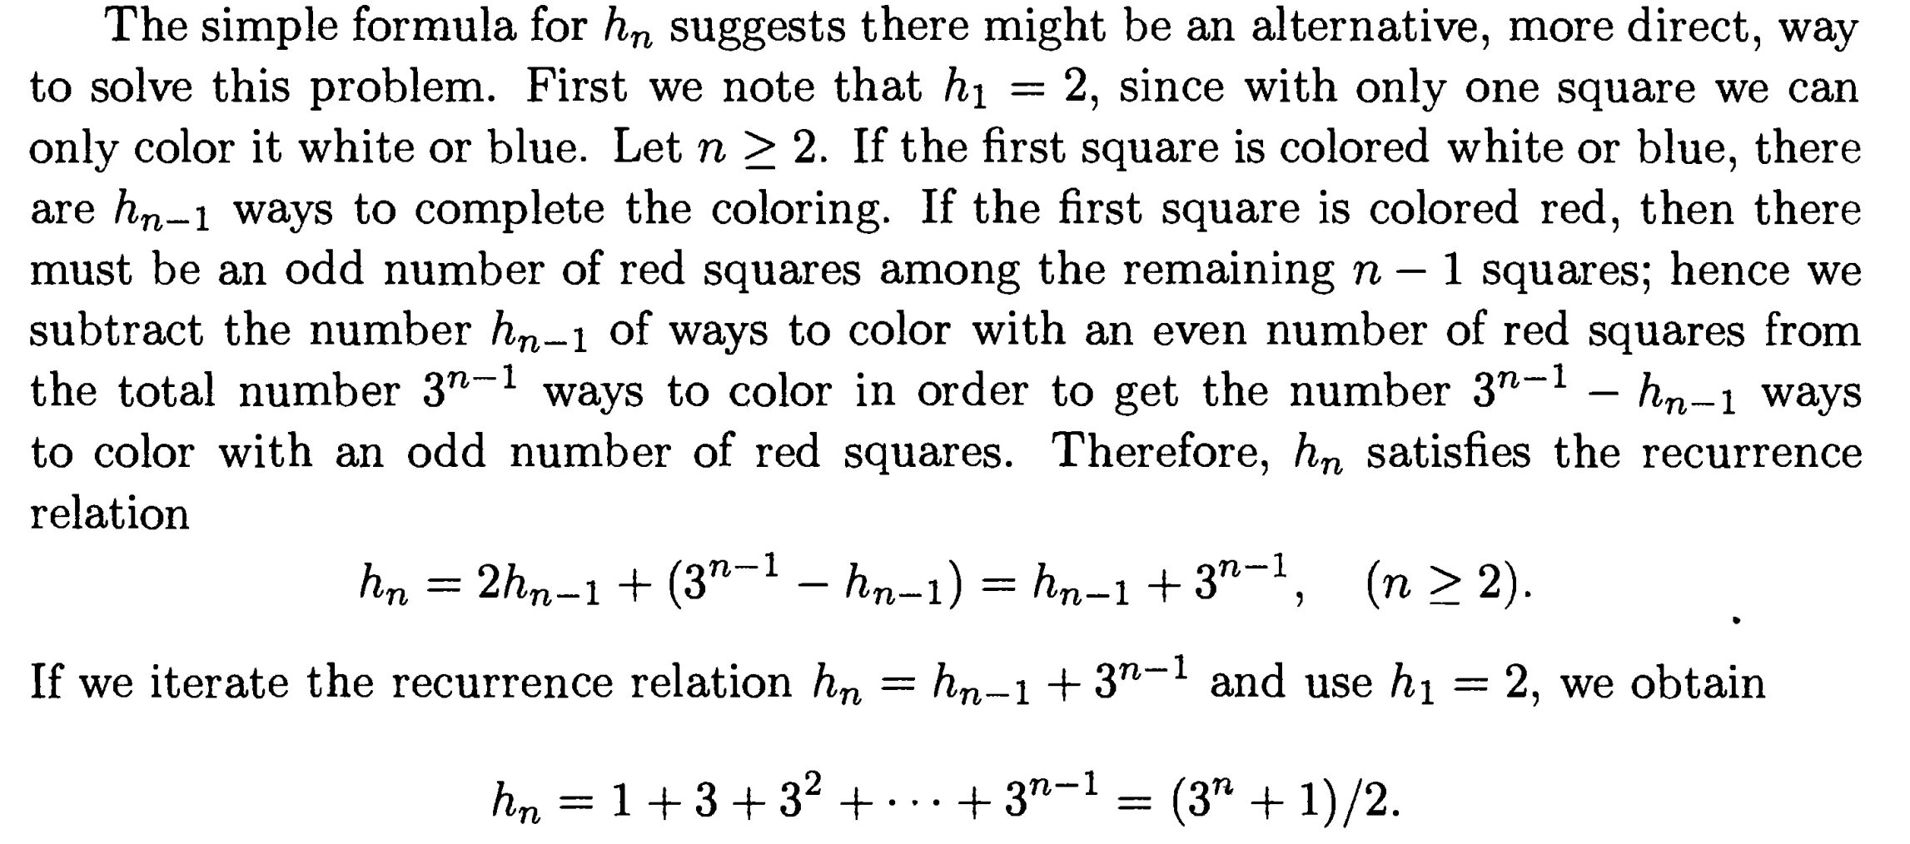

Slide 57
Exercises
Determine the number h_{n} of n digit numbers with each digit odd where the digits 1 and 3 occur an even number of times.
Hints: let h₀ =1. the number h_{n} equals the number of n-permutations of the multiset S = {∞1, ∞3, ∞5, ∞7, ∞9}, in which 1 and 3 occur an even number of times. ……..

Slide 58
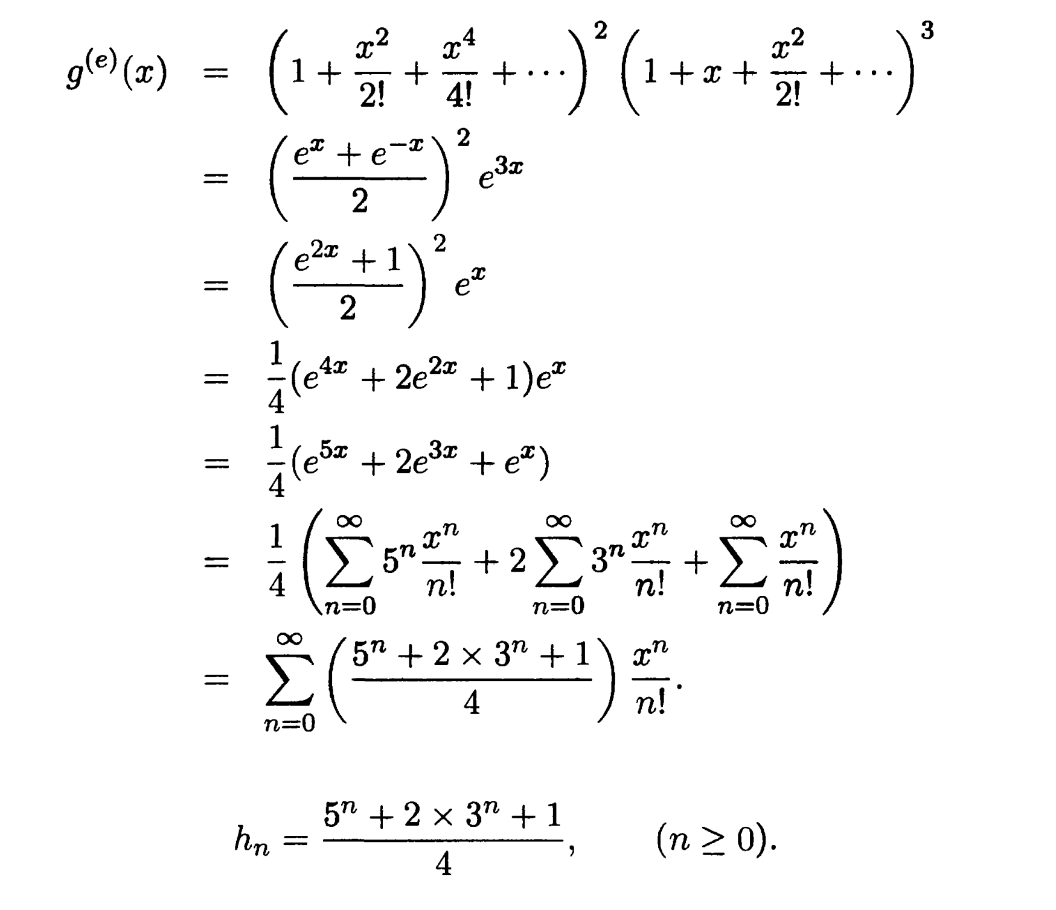

Slide 59
Exercises (cont’d)
Determine the number of ways to color the squares of a 1-by-n chessboard, using the colors red, white, and blue, if an even number of squares are to be colored red and there is at least one blue square.

Slide 60
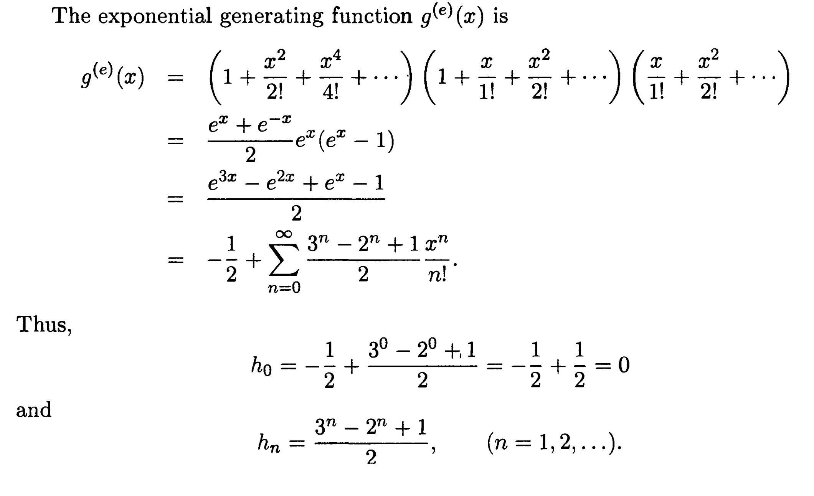

Slide 61
Assignments
  9
  16
  25
  48(b)

